Slide 1
Unsupervised Anomaly Detection in Financial Transaction Graphs
Coen Valk

Slide 2
Agenda
Problem Statement
Method
Datasets
Don2Com
Project Caviar - Canadian Drug Trafficking Dataset
Bitcoin Transaction Dataset
Algorithms
Direct Neighbor Outlier Detection Algorithm (DNODA)
Community Neighbor Algorithm (CNA)
Global Outlier Detection Algorithm (GLODA)
OddBall

Slide 3
Problem
What attributes do illegitimate transactions possess?
How do we find which transactions are illegitimate?
How accurate is unsupervised anomaly detection in financial networks?

Slide 4
Method
Apply all three algorithms to all original datasets
Observe which nodes and edges are consistently flagged as anomalous
Intentionally add anomalous nodes to each graph
10%
25%
50%
80%
100%
Observe how many of the anomalous nodes are flagged

Slide 5
Datasets - Don2Com
Federal Election Commission data
Weighted graph of donations from individuals to committees and political candidates
Also used by the 2010 paper detailing the OddBall algorithm
Can we scope out meddling in elections?

Slide 6
Datasets – Project Caviar
Dataset detailing links between drug trafficking deals
Show the limits of an unsupervised algorithm
All these transactions would be considered illegitimate or anomalous in a graph with larger context

Slide 7
Datasets - Bitcoin Transaction Dataset
Large weighted dataset of transactions over bitcoin blockchain
Show the “ideal scenario” of anomaly detection
Network contains both legitimate and illegitimate nodes
Stress test the performance of each algorithm
Dataset contains several million transactions

Slide 8
Algorithms – DNODA, CNA, GLODA
Direct Neighbor Outlier Detection Algorithm (DNODA)
Determine whether a node is an outlier based on the data of direct neighbors of that node
Community Neighbor Algorithm (CNA)
Determine whether a node is an outlier based on the data of direct neighbors of that node
Several methods for community detection, as we’ve seen in class
Global Outlier Detection Algorithm (GLODA)
Determine whether a node is an outlier based on the data of all other nodes in the graph

Slide 9
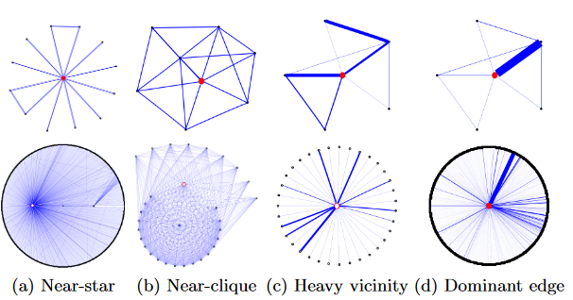
Algorithms - OddBall
Identifies 4 different kinds of anomalous vertices
Near-star
Near-clique
Heavy vicinity
Dominant edge

Slide 10

Questions?

Slide 11
References
Akoglu, Leman, et al. “Oddball: Spotting Anomalies in Weighted Graphs.” Advances in Knowledge Discovery and Data Mining Lecture Notes in Computer Science, 2010, pp. 410–421., doi:10.1007/978-3-642-13672-6_40.
Vengertsev, Dmitry, and Hemal Thakkar. Anomaly Detection in Graph: Unsupervised Learning, Graph-Based Features and Deep Architecture.
Coscia, Michele and Viridiana Rios (2012). Knowing Where and How Criminal Organizations Operate Using Web Content. CIKM, 12 (October – November).

